Slide 1

Welcome to Bokeh.
(Yes, after this lightning talk you can now add Bokeh to the skills section of your resume!)
Jonathan Beatty

Slide 2
What is Bokeh?
Bokeh is a python library for interactive visualization that can target web browsers for representation.
You can pass data of all sorts, such as Python lists or tuples, NumPy arrays or Pandas DataFrames to make your plots.
Other languages supported by Bokeh:
Bokeh for R
Bokeh for Scala

Slide 3
Why use Bokeh?
Interactivity
Ease of representation online
Complex statistical plots quickly through simple commands.
Can transform visualizations from matplotlib, seaborn and gg plot.

Slide 4


Easy Install

Slide 5
Outputting Bokeh Files
3 way to output Bokeh:
HTML
2. Notebook
3. Server
Can embed Bokeh visualization to Flask and Django App.

Slide 6
Three Shades of Bokeh
Charts
High level use of Bokeh used to build complex statistical plots. Main benefit of Bokeh as opposed to matplotlib or another visualization library at this level is interactivity
Plotting
Mid level use of Bokeh. Centered around composing visual glyphs and building plots on one another. Very useful for Geo-Spatial Data!
Models
Low level of Bokeh. This is best used for advanced users or developers who want even more control over the creation of glyphs and all aspects of Bokeh

Slide 7
Creating a Chart
Import the library and functions/methods
Prepare the data
Set the output mode(notebook, web browser, server)
Create a chart with styling options
Visualize the chart

Slide 8
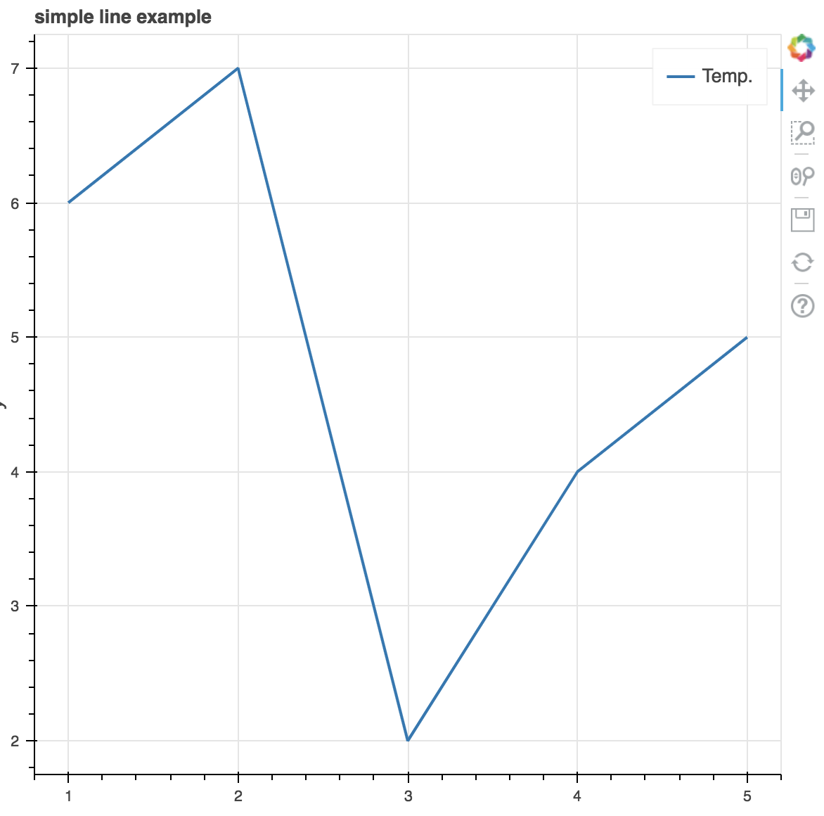
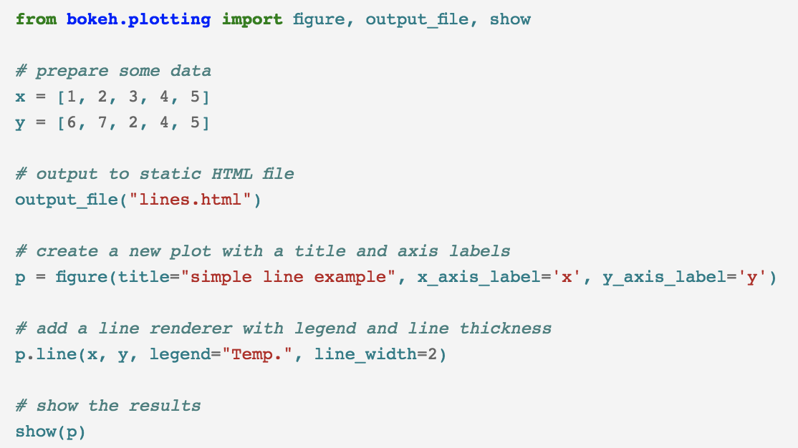
Visualizing the Chart

Slide 9
Creating a Plot
Import library, methods or functions
Select the output mode
Activate a figure
Perform subsequent plotting operations, it will affect the generated figure(glyphs)
Visualize it

Slide 11
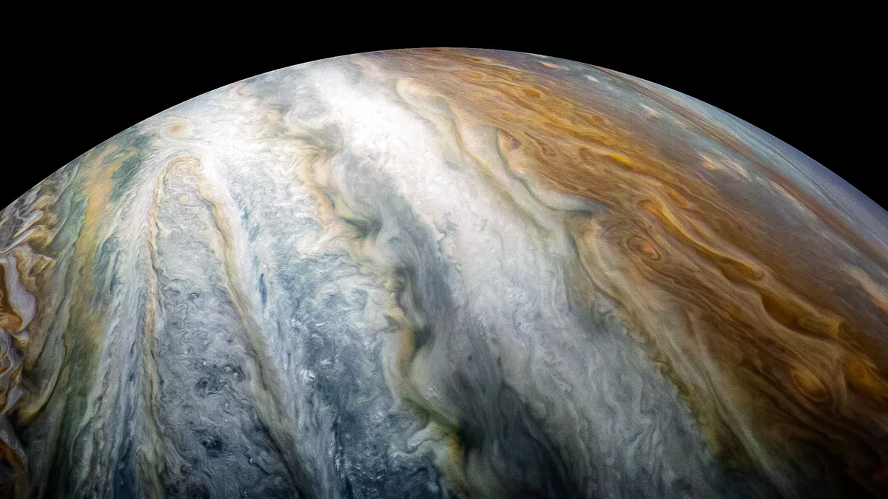
Reddit’s Top Models
TO JUPYTER!!

Slide 12
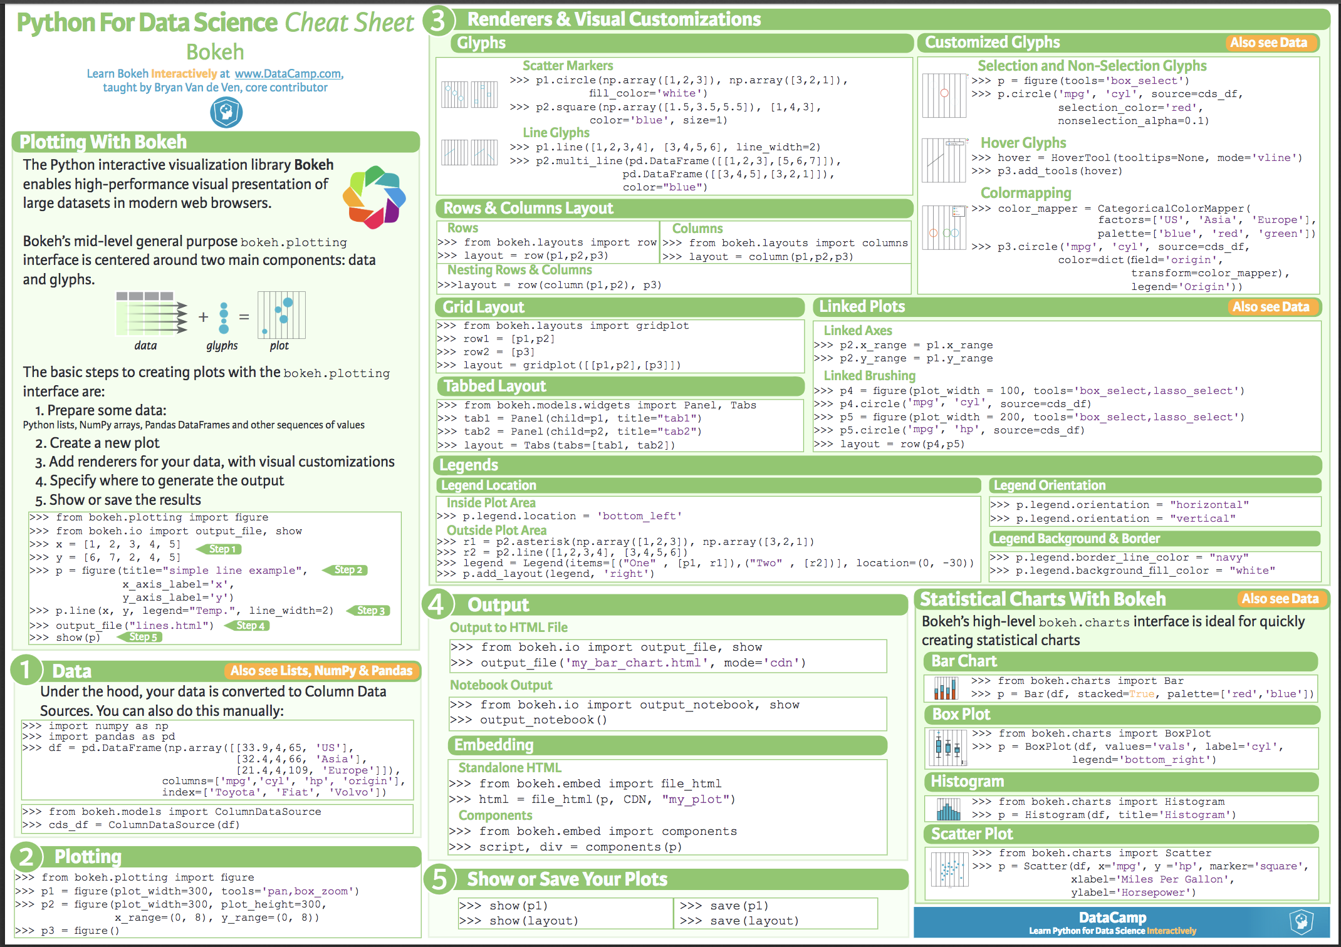
Cheat Sheet for Bokeh thanks to DataCamp!

Slide 13
Bokeh Application Server
Bokeh also comes with an optional server component, the Bokeh Server, below is a sample of uses for the server:
UI widgets and plot selections driving computations and plot updates.
Intelligent server-side downsampling of large datasets.
Streaming data automatically updating plots.
Sophisticated glyph re-writing and transformations for “Big Data”.
Plot and dashboard publishing for wider audiences.

Slide 14
Questions???
Thank you for your attention!

